Slide 1
Logic and Probability
for Statistics
Gale Lucas
lucas@ict.usc.edu

Slide 2
Today’s Topics
Descriptive statistics
Probability for statistics
Logic for statistics
Logic meets probability
NHST example
Sampling distribution

Slide 3
Descriptive Statistics

Slide 4
What is a Mean (M)?
Measurement of central tendency
Mathematical midpoint (average) of a data set

Slide 5
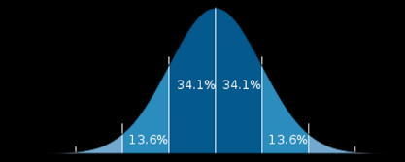
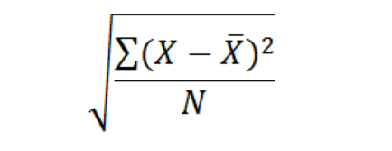
Standard Deviation (SD)
Measurement of variability
How variable is the data?
How close to the mean is a given value?

Slide 6
Target of descriptive statistics
Descriptive statistics can be run on the entire population
We usually cannot collect all the data for the entire population
Take a sample
Given a large enough sample size (N), sample M and SD are usually fairly close to the population M and SD, respectively.
Either way, they are still our best guess for population M and SD

Slide 7
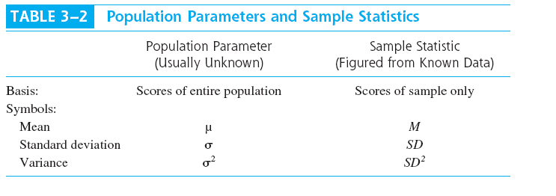
Sample vs Population notation

Slide 8
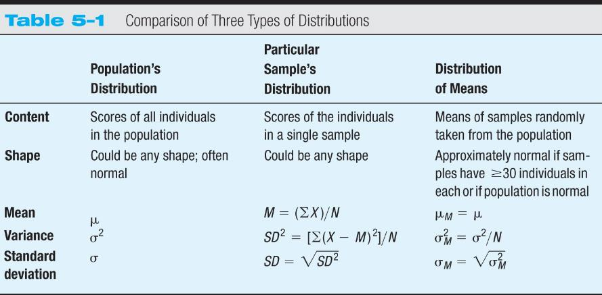
Sample vs Population notation

Slide 9
Probability for Statistics

Slide 10
NHST
Null hypothesis significance testing
A systematic procedure for deciding whether the outcome of a study (results from a sample) support a particular theory (which is thought to apply to a population)

Slide 11
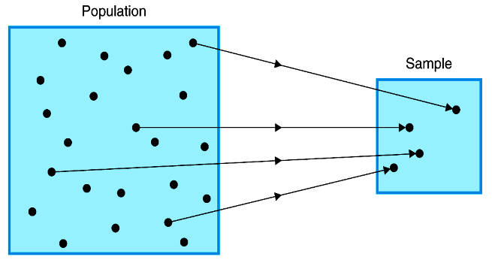
NHST
Null hypothesis significance testing
The SAMPLE is what is studied and the POPULATION is what you draw conclusions about

Slide 12
How good a job are we doing of inferring about the population…?
Probability—The expected relative frequency of a particular outcome
But what does expected relative frequency mean????
Relative frequency - # of times something happens relative to # of times it could have
4/10
Expected relative frequency (probability)
if infinitely flipped coin…

Slide 13
Probability
Probability = p = # ways to get an outcome
# possible outcomes
Probability (heads) = only 1 way to get heads
2 possible outcomes
= expected relative frequency
= 1/2

Slide 14
Probability
Bag of candy contains:
20 strawberry pieces
20 orange pieces
20 cherry pieces
20 lemon pieces
What is probability of choosing one that is lemon?
What is the probability of choosing a lemon or a cherry candy?
Must put it back for that to be true!

Slide 15
Probability
proportion - 0 to 1.
“cannot happen” to “it must”
getting a blue candy v. if only contains red candy
5/100 or .05 - unlikely (p is very low)
E.g., 95 red candies and 5 yellow
Unlikely that if we have a yellow candy, it came from that bag
very low but….
Just what we are doing in hypothesis testing!!!
Is it an unusual enough value that there’s a low change (.05 or 5%) that it came from the “population”?

Slide 16
Logic for Statistics

Slide 17
NHST uses deductive reasoning
Deductive Reasoning: From general to specific
Theory to hypotheses…
USC students are hard working
Student in my class should be hard working
Inductive reasoning: From specific to general
Observations to theories…
Student in my class is hard working
USC student is hard working
Null hypothesis significance testing
Sherlock Holmes

Slide 18
Deductive Reasoning
For example, we might hypothesize that "The color of a mineral is determined by its crystal structure."
And so we could test this hypothesis using deductive reasoning:
If this is true, then all purple minerals should have the same crystal structure. But purple amethyst has a hexagonal structure and purple fluorite has an isometric structure. So…

Slide 19
Here’s where the logic gets complex
Science determines “the truth” in a counter-intuitive way: trying to disprove the opposite
Why? Cause its easier to disprove than prove!
All human females have brown hair
If so, my cousin and my aunt should have brown hair
Cousin: supports, but could have supported lots of conclusions…
Aunt: falsified my theory!

Slide 20
We can’t prove theories
We only have to find one false case to disprove (but we’d have to look at every possible positive case to PROVE it!)
So, we don’t examine every instance
Thus we never PROVE a theory!!!
Instead we try to falsify the opposite

Slide 21
What exactly are we trying to disprove?!?
In NHST, our hypothesis is usually ‘there’s an effect’
What is the opposite hypothesis?
“No effect”
AKA The null hypothesis
So, to support our hypothesis, we want to REJECT the null hypothesis
Disprove “no effect” suggests that there is an effect!!!!!!
But, there is ALWAYS a chance of error – this is designated by the p value
So we really say: its very unlikely there is no effect!
Notes:
21

Slide 22
Logic Meets Probability

Slide 23
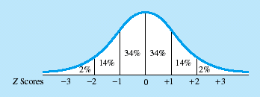
Logic Meets Probability
If we pull an extreme enough score, we feel confident rejecting the null hypothesis (that there is no effect)
p < .05
We’ll use what we will learn about normal distributions to figure out the probability of that score (so we can know if its extreme enough to reject the null)

Slide 24
Normal Curve
Unimodal, symmetrical, bell-shaped curve
Mathematical (or theoretical) distribution
Why is this curve common?

Slide 25
Normal Curve
Memorize the 34-14-2 numbers!
what percent of scores are:
within 1 standard deviation on either side of the mean?
within 2 standard deviations on either side of the mean?

Slide 26
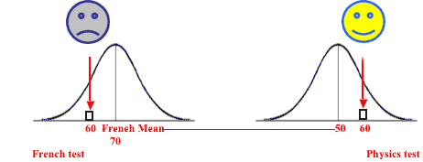
Our next question…
At times it is difficult to compare raw scores because raw scores may not give an accurate picture of one’s relative standing

Slide 27
Z-Scores
How much is a score below or above average?
Example: 60 on exam
can transform scores by standardizing them (making them z-scores)
represents one score’s standing in the distribution relative to others
A Z-score is the number of standard deviations the score is above or below the mean
** How far a person is from the mean in standard deviation units **

Slide 28
Standardization
Standardization: Process of converting raw scores into Z-scores
Raw score—in original units
Z-score—in SD units (number of SDs above or below the mean)
Units = SDs
Mean = 0, SD = 1
Same shape as the unstandardized scores

Slide 29
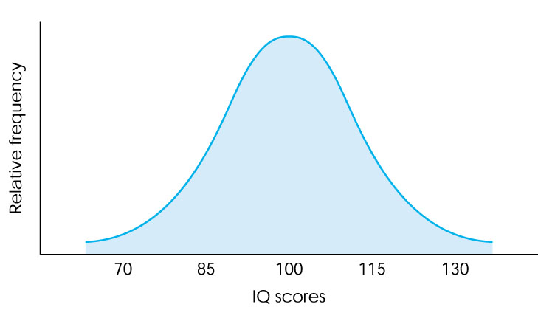
A distribution of scores

Slide 30
The distribution following standardization (aka Z-score transformation)
-2 -1 0 1 2
-2 -1 0 1 2

Slide 31
Calculating a Z-Score
Exam 1 score = 65, mean = 70 and sd = 5
A z-score of -1 indicates that your score is 1 standard deviation below the mean
= -1

Slide 32
Practice
If score = 90, M = 50 and SD = 10, what is Z?
If score = 80, M = 100 and SD = 10, what is Z?

Slide 33
Normal Curve
So let’s go back to our 34-14-2 numbers

Slide 34
Normal Curve
95%
1.96
1.96
2.5%
47.5%
47.5%
2.5%
p < .05 (below -1.96 & above 1.96)

Slide 35
Normal Curve
1.96
1.96
Can use a Z-table to find exact p value for your z
E.g., z-score of 2.58 has p = .01
That is how unlikely your value would be given the null hypothesis
z-score of 1.65 has p = .10

Slide 36
RECAP: Logic Meets Probability
If we pull an extreme score, we feel confident rejecting the null hypothesis (that there is no effect)
Use what we learned about normal distributions to figure out the probability of pulling a score

Slide 37
NHST Example

Slide 38
NHST
Null hypothesis significance testing
A systematic procedure for deciding whether the outcome of a study (results from a sample) support a particular theory (which is thought to apply to a population)
Scenario: Do people who engage in Social Networking (SNing) have higher IQs?

Slide 39
IQ: µ = 100; σ= 15
Distribution of IQ scores
Null hypothesis: no effect
If IQ score from someone who engages in SNing is unlikely enough* given this population, then reject that null?
Outcome of a study (results from a sample) support a particular theory
* < .05

Slide 40
Example
Comparing a person engaging in SNing to normal population
not usually used to draw conclusions
After, IQ is 138.7
Is this an unusual score?
Convert to a Z-score.
Now, what is the likelihood of that score? (look back…)
Can we reject the null hypothesis?
Do we think social networking matters?
Can we be sure? What is our chance for error?
IQ: µ = 100; σ= 15

Slide 41
Why are we using the distribution of normal IQ scores again?
…when we want to ask: Do people who engage in SNing have higher IQs?
Don’t know distribution of IQ for those engaged in SNing — only for the general pop.
And, recall, its easier to disprove…
We reason: If it’s unlikely that this score came from a distribution/population where there is no effect (eg. normal IQ scores), then “no effect” probably isn't true
Reject the null hypothesis

Slide 42
Another Example: rejection by peers & self-esteem
Hypothesis: children who are rejected by peers have lower self-esteem
Null hypothesis?

Slide 43
Another Example: rejection by peers & self-esteem
Child who was rejected by peers – self-esteem score = 5
What’s the Z-score (if µ=10 and σ=1)?
-5
p < .05, so we reject the null hypothesis
highly unlikely for this child to have been from the general population
1.96
1.96

Slide 44
Another Example: rejection by peers & self-esteem
What if the Z-score had been -1?
We fail to reject null hypothesis and this means that the study is inconclusive
However, that’s NOT accepting the null hypothesis
The probability was not enough for us to reject the null
Was a difference but it was too small

Slide 45
Sampling Distribution

Slide 46
Sample
So far just single individual
locate that individual in a distribution of individuals
Highly unusual in science

Slide 47
What about this?
IQ of 5 people who engaged in SNing:
98, 103, 72, 149, 180
Can we just take the mean and proceed as we have been?

Slide 48
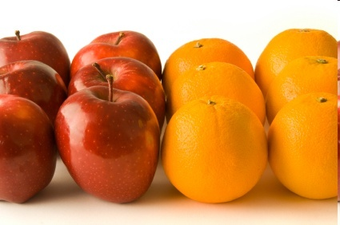
Samples
No, cant compare a mean to a distribution of individuals - - - we need a different comparison distribution
A distribution of means!
Specific to the sample size (N = 5)

Slide 49
Sampling distribution
ONE individual
-> distribution of individual scores
MEAN
-> distribution of means
aka: Sampling Distribution

Slide 50
Sampling distribution
Repeatedly taking random samples (of specific size, “N”), then make a distribution of their means
Now have a set of means (can display in histogram), has same properties as we’ve been leveraging so far…

Slide 51
Standard Error (SE)
Measurement of variability OF SAMPLES
How FAR from the “mean of means” is our data set’s mean?
Mean of all the sample’s means
Is it far enough from the mean of means that its unlikely to have come from this sampling distribution (.05 or 5% chance of error)?
Sampling distribution

Slide 52
Sample vs Population notation

Slide 53
Computing Z-score
IQ of 5 people that engaged in SNing:
98, 103, 72, 149, 180
Z = (M - μ_{M} ) / σ_{M}
μ_{M} = mean of the distribution of means
σ_{M} = standard deviation of the distribution of means aka “standard error (SE)”

Slide 54
Sampling distribution
How will you know if you need a sampling distribution?
If testing an individual score, no; but if testing a sample mean, yes

Slide 55
Distribution of Means
What are it’s characteristics?
Mean?
Variance?
Shape?
Central Limit Theorem
μ_{M} = μ
σ²_{M} = σ²/N (σ_{M} = σ/√N)
The distribution of means will be normally distributed if EITHER:
The population is normally distributed -- OR --
The sample size is >= 30

Slide 56
CLT
μ_{M} = μ
no systematic bias… for any sample, will approach mu.
Why not exactly the mean?
σ²_{M} = σ²/N (σ_{M} = σ/√N)
What happens as N ↑?
Why might less variability be good for us?

Slide 57
CLT
The distribution of means will be normally distributed if EITHER:
The population is normally distributed -- OR --
The sample size is >= 30
Important because we assume a normal distribution in our statistics

Slide 58
Recap
How will you know to construct a distribution of means (sampling distribution) or to use population distribution?
What happens to SE as N goes up?
How does sampling distribution differ from the general population distribution?
Also: so far, still know mu & sigma

Slide 59
Practice
Z = (M - μ_{M} ) / σ_{M}
Scores are normally distributed with µ = 500 & σ = 3.
(σ_{M} = σ/√N)
What is our standard error if sample size is 9?
Is a sample mean of 502 statistically significantly higher?
What if our N was smaller?

Slide 60
Sampling distribution
For these examples, we have access to μ and σ – that's also unusual
Called a Z test - Compare Z-scores
locate our sample score on a distribution by converting it to a Z-score (known properties)
technically also did for single scores...
Usually have to estimate mu & sigma based on sample M & SD
Z is just one “test statistic” that can have a sampling distribution
All test-statistics (Zs, Ts, Rs, Fs, Chi-squares, Bs) have their own sampling distribution
Same logic and overall process apply for those

Slide 61
For example
Single sample t-test
Like Z test, but you estimate σ²_{M} from sample standard deviation (special formula for sample variance)

Slide 62
N-1?
degrees of freedom (df)
scores that are “free to vary”
M=5
5 scores:
4
5
6
5
????
How many “are free to vary?”

Slide 63
Calculating Sum of Squares
Score | (X-M) | (X-M)²
3 | -2 | 4
5 | 0 | 0
6 | 1 | 1
7 | 2 | 4
M = 5
4
-1
1
SS = 10

Slide 64
N-1?
If know M, N-1 scores are free to vary
Once know those, last score & variance are set
We use N-1 when estimating σ because allows for an unbiased estimate

Slide 65
For example
Single sample t-test
Like Z test, but you estimate σ²_{M} from sample standard deviation (special formula for sample variance)
S²_{M} = S² / N

Slide 66
Now calculate…
Z-score, right?
Why not?
Z only works if you know σ
equivalent if estimating σ: t-value
Before, comparison was distribution of means converted into their Z-scores
So now….

Slide 67
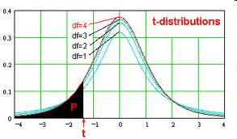
Distribution is not quite “normal”
With small N, can get scores that are really all close together -> fat tails
differences?
tails
vary shape
As df -> ∞…
With larger N, this is almost σM
Notes:
Becomes more like a z-distribution

Slide 68
Cutoff for t-test
Find a t-table
Cutoff varies with df, because of changing shape of distribution
When use a Z-test vs t-test?
Other kinds of t-tests!?!

Slide 69
Today’s Topics
Descriptive statistics
Probability for statistics
Logic for statistics
Logic meets probability
NHST example
Sampling distribution

